Slide 1
19CSE204 – Object Oriented Paradigms
Lecture 2 – Object Oriented Concepts
Content Courtesy
Lecture Slides by Ms. Nalinadevi K.,
Asst. Professor, CSE

Slide 2
Concepts
Class
Object
Abstraction
Encapsulation
Inheritance
Polymorphism
Re-usability
Modularity
Strong Typing
Concurrency
Persistence

Slide 3
Class
User-defined data type
Blue print/plan
Data and code that work on that data
Collection/ description of objects of similar types

Slide 4
Objects
Basic run time entity
Instance/variable of a class
Takes up memory
Types:-
Physical objects
Elements of computer-user environment
Data Storage constructs
Human entities
Data collection
User defined data types

Slide 5
Abstraction
Act of representing essential features without including background details or explanations
Focuses upon the essential characteristics of some object, relative to the perspective of the viewer

Slide 6
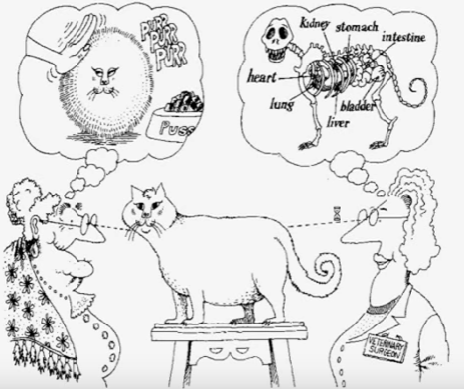
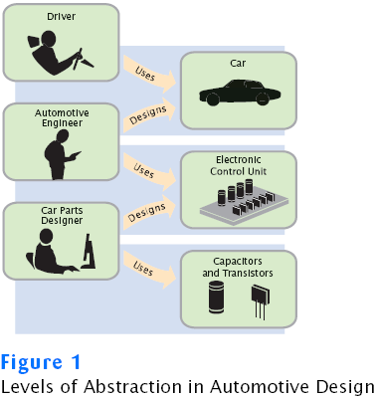
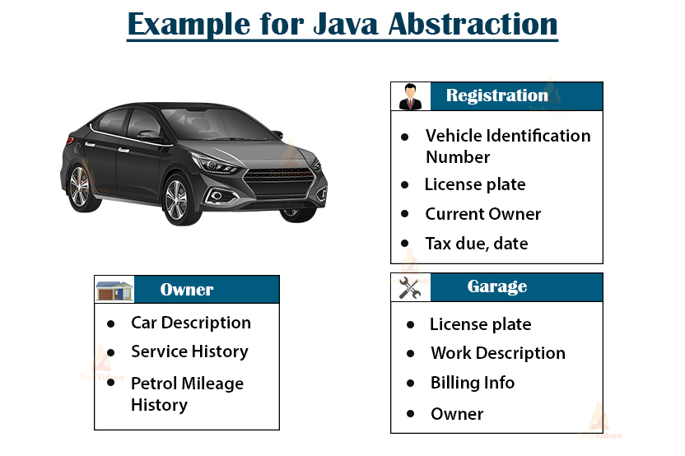
Abstraction - Examples
TV
Switch on, change channels, adjust volume, ….
Not bothered about how the signal is transmitted, how it is received and converted to picture

Slide 7
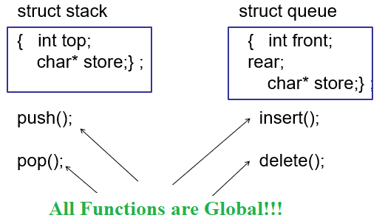
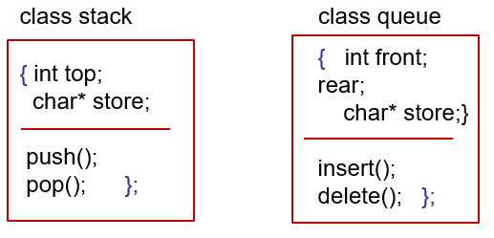
Abstraction
Problem with PPL – All Functions are global; data is shared
OOPL → Class = State+ Behaviour → Better Abstraction

Slide 8
More details on Class
Class = State + Behaviour
State → data members, fields or properties
Behaviour → Member functions or methods
An example : car
State
colour, manufacturer, cost, owner
Behaviour
Drive it, lock it, carry passengers in it

Slide 9
More details on Objects
Object : data and behaviour
Properties or attributes describe state of the object (data)
Methods or procedures define behaviour
An object has state, exhibits some well defined behaviour, and has a unique identity.
Class: “Group of objects with similar structure & common behaviour”
A class represents a set of objects that share a common structure and a common behaviour.
Specifies structure, behaviour and inheritance
Object becomes an instance of a class

Slide 10
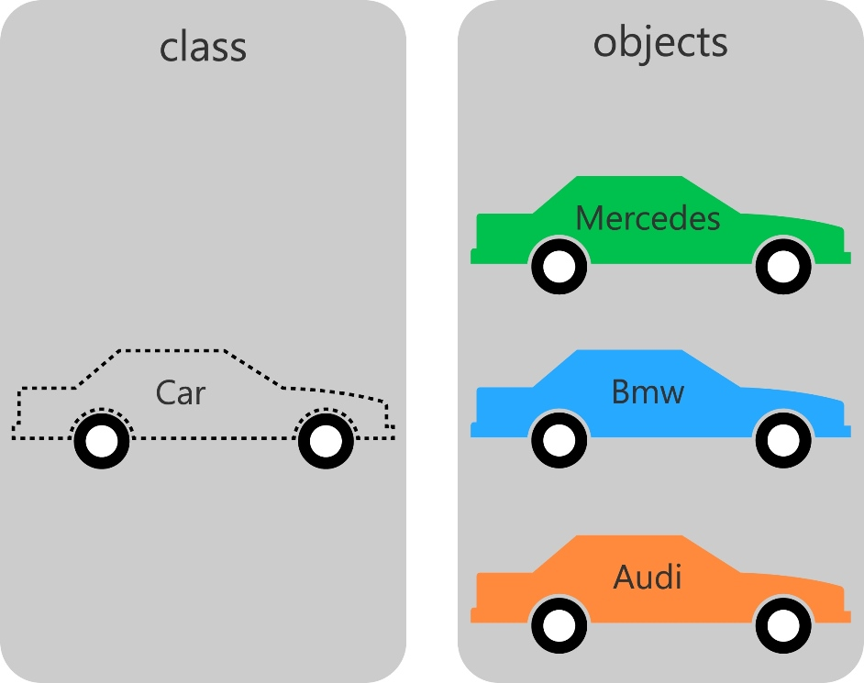
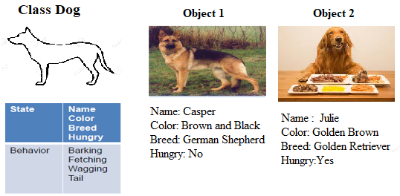
More details on Objects
Image Courtesy: http://phpenthusiast.com/object-oriented-php-tutorials/create-classes-and-objects
https://previews.123rf.com/images/yakotina/yakotina1602/yakotina160200027/52723611-vector-image-of-an-outline-dog-silhouette-on-white-background.jpg, Google Images

Slide 11
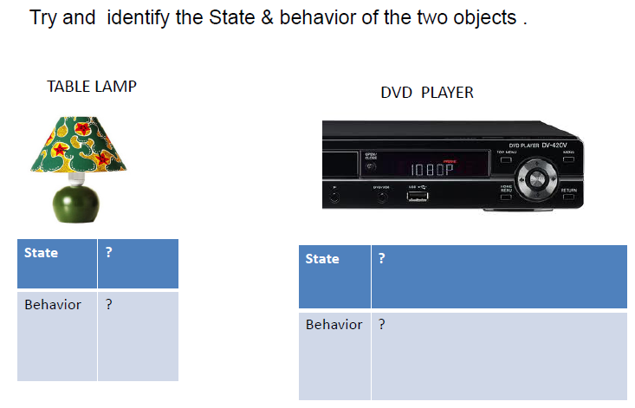
Try yourself

Slide 12
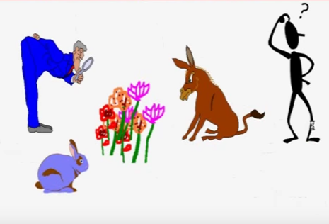
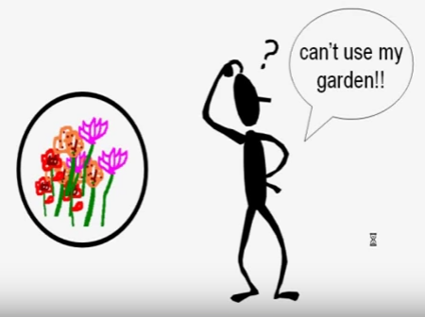
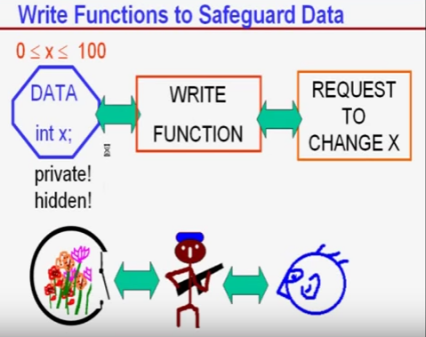
Encapsulation

Slide 13
Encapsulation
Wrapping up data and functions into a single unit - hides the details of the implementation of an object.
Data accessibility is limited to class member functions
Member functions act as interface between class object’s data and rest of the program
DATA HIDING – Insulation of data from direct access by program

Slide 14
Encapsulation - Rules to be followed in OOP
FIRST LAW OF OOP: Data must be hidden, i.e., PRIVATE
Read access through read functions
Write access through write functions
For every piece of data, 4 possibilities
read and write allowed
read only
write only
no access

Slide 15
Encapsulation
0 ≤ x ≤ 100
Data
int x;
Write Function
Request to change X
Private!
Hidden !
void modify_x(int newval)
{
if(newval>100 || newval <0)
PRINT ERROR AND EXIT
else
x = newval;
}

Slide 16
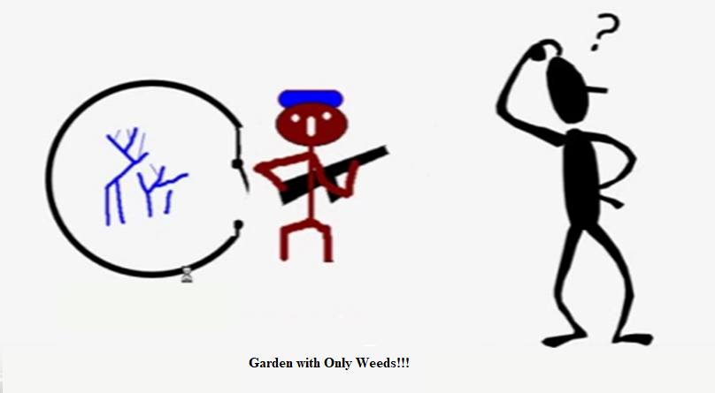
Encapsulation
Problem of Improper Initialization → Garbage values for data members
How to Handle it?
CONSTRUCTORS

Slide 17
Constructors and Destructors
Special Member Functions
Constructor
ensure correct initialization of all data
automatically called at the time of object creation.
Destructor
ensure correct deallocation of all resources before an object goes out of scope.

Slide 18
Holi Trinity of OOP in the Life Cycle of an Object
An OBJECT is
Born Healthy : Constructor(s)
Live Safely : Read/Write Functions
Dies Cleanly : Destructor
Other objects can change the state of an object by using only those methods that are exposed to the outer world through a public interface. This help in data security.
PRIVATE
PUBLIC
Data
Read/write
Functions
Public interface of the class
Constructors
Destructors
Private Functions
ADT Functions

Slide 19
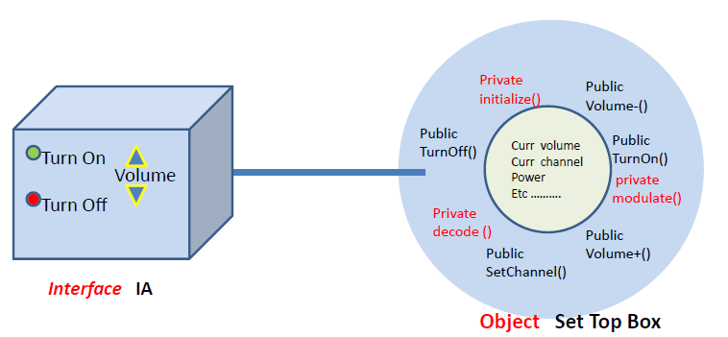
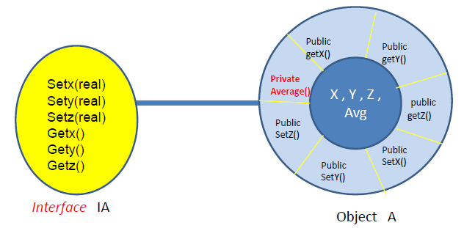
Using Public Interface - Examples
Real-World Example
Programming Example

Slide 20
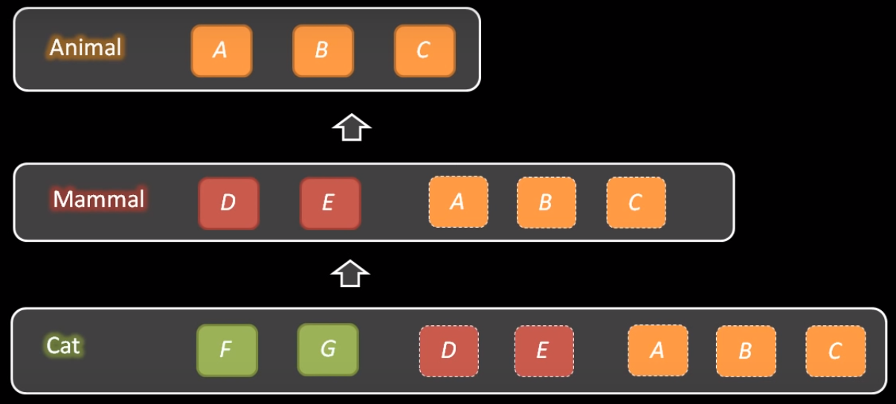
Inheritance
Process by which objects of one class acquire the properties of another class
Hierarchical Classification
Each sub-class shares common attributes with its ancestors - A subclass may inherit the structure and behaviour of its superclass
Each sub-class can have its own additional features
Original Class – Base Class; Sub-classes – Derived classes

Slide 21
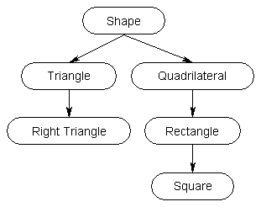
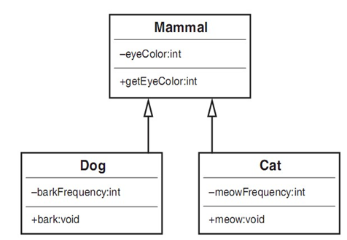
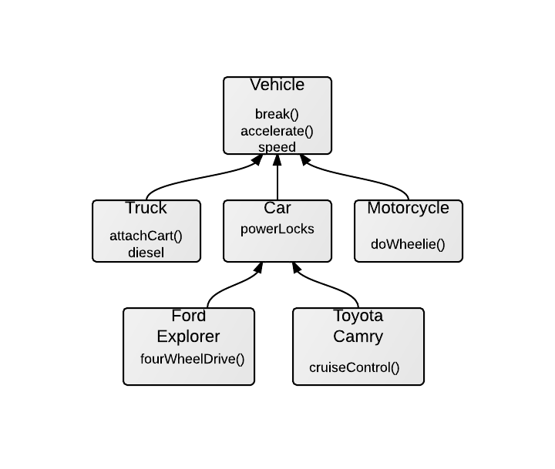
Inheritance

Slide 22
Inheritance - Advantages
Re-usability
Once a class is created and debugged, it can be distributed to others for use
Take an existing class, modify it or add additional features/capabilities to it
Ease of use
Polymorphism
Ability to take more than one form
Operation exhibits different behavior in different instances depending upon data type
Provides same external interface for objects with different internal structure

Slide 23
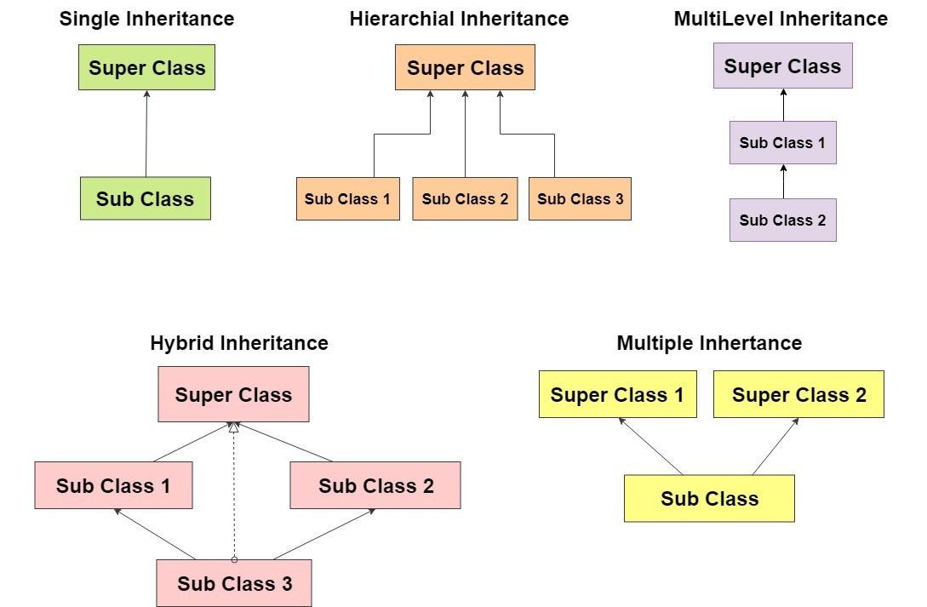
Inheritance - Types

Slide 24
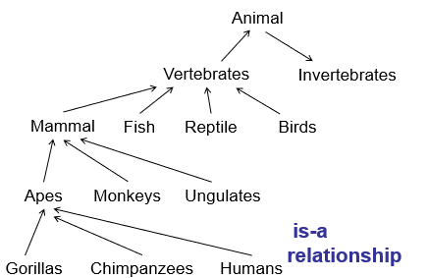
Is-A Relationship
Easier to maintain and fix bugs

Slide 25
Multiple Inheritance - Caution
A
Complicated structure
More difficult to maintain and fix bugs
Ambiguity in function calls.
B
F
E
D
Horse
eat()
Eagle
eat()
G
Flying Horse
H
eat()?

Slide 26
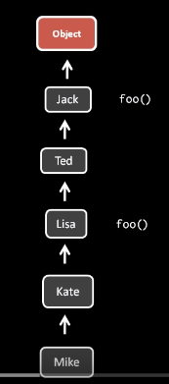
Overriding
Redefining a inherited method
Depends on the type of object

Slide 27
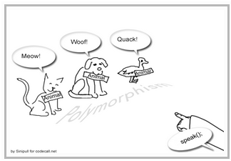
Overloading
Same operation behaving differently on different classes
Method is same, implementation invoked will be different
Symbol ‘+’ ➔ Addition for numbers, concatenation for strings

Slide 28
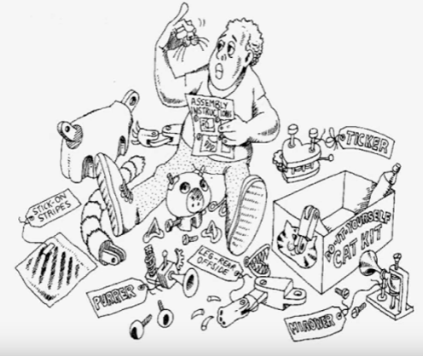
Modularity
Modularity packages abstractions into discrete units.
Classes
Packages
Domains

Slide 29
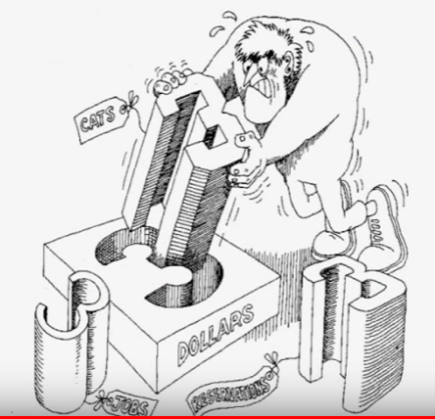
Strong Typing
Prevents mixing abstractions
X = Y is allowed only if X and Y are objects of the same class.

Slide 30
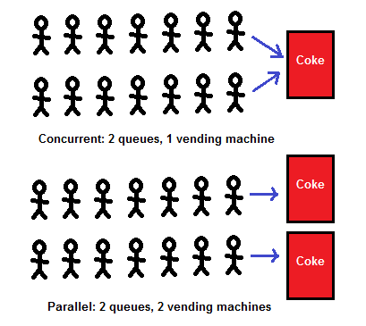
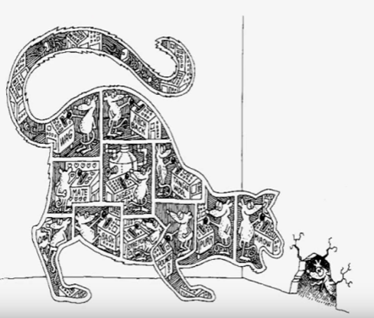
Concurrency
Allows different objects to act at the same time
Multi-threading
https://miro.medium.com/max/409/1*_4B2PKsJn9pUz3jbTnBnYw.png

Slide 31
Persistence
saves the state and class of an object across time and space, i.e., storage on permanent storage media.
Object Serialization is supported in Java.
Can also use mapping to RDBMS using some Object/Relational Mapping Scheme

Slide 32
Thank You!!!

